Slide 1


Slide 2
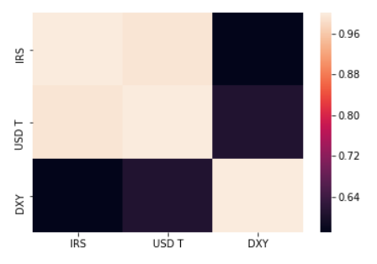

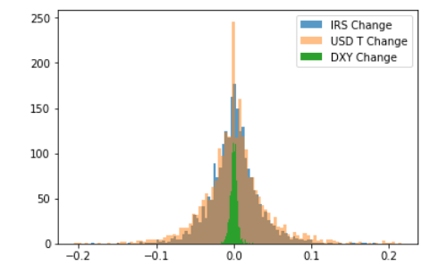


Data Exploration
Interest Rate Swap
3 Years
Treasury Yield
U.S Dollar Index
change
2010
2019
2345 DAYS

Slide 3
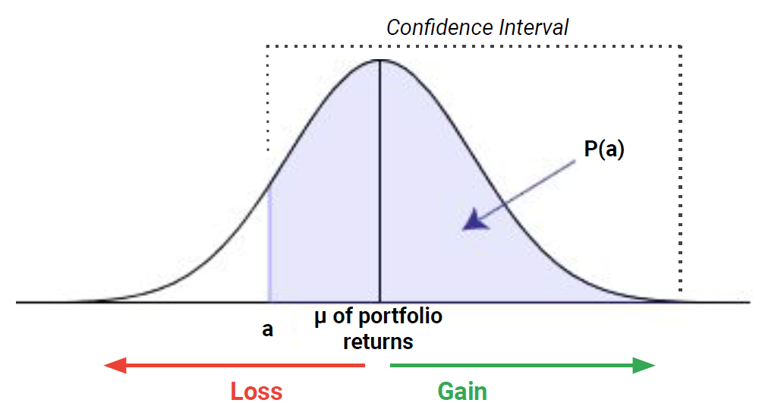

What is Monte Carlo Simulation?
%95
***In order to model the probability of different outcomes in a process that cannot easily be predicted due to the intervention of random variables.
a: the maximum amount of loss
P(a): at a given probability
μ – z_{x}
*σ

Slide 4

How we applied the Monte Carlo Simulation?
What we have?
-469 weekly IRS change and DXY change
What is our assumption?
-Assumed that we are in 260th week and cruious about changes in IRS arises from previous data
What is our result?
- Compared actual data and our Monte Carlo estimations; 11 estimations are different out of 208 estimations

Slide 5
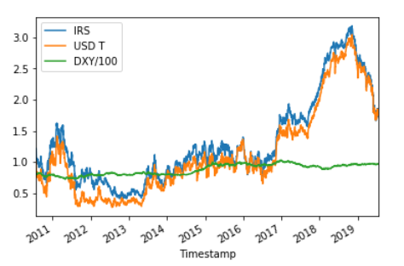
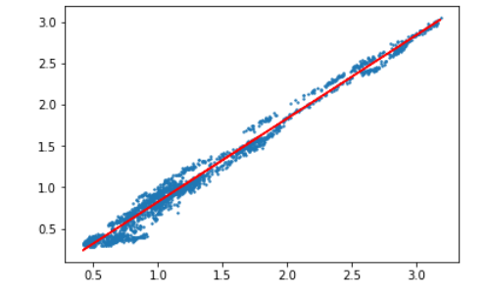
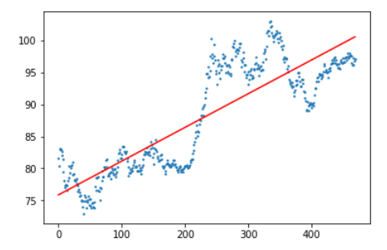
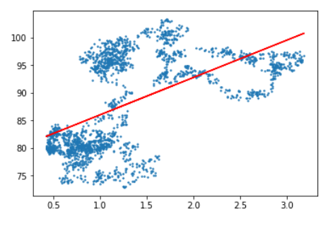
Linear Regression
USDT
IRS
DXY
DXY
week
IRS

Slide 6
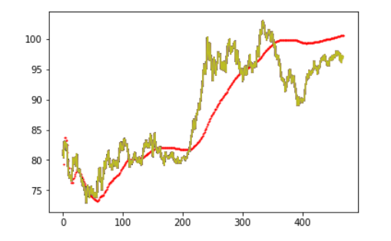
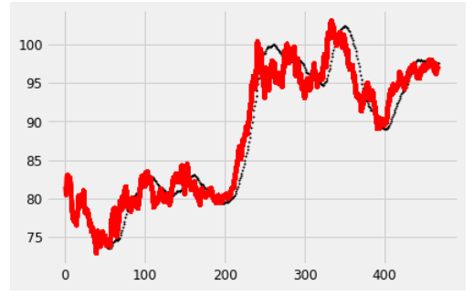
Linear Regression
DXY
DXY
week
week
**Cumulative**
**Only 52 Weeks**

Slide 7
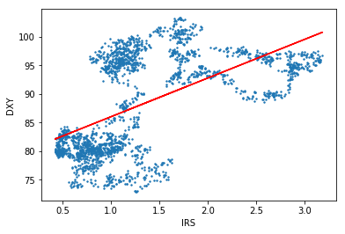
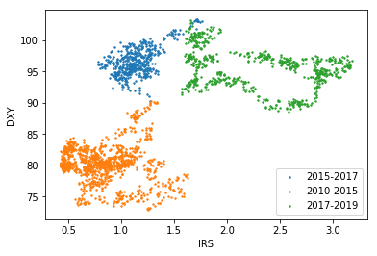
k-NN

Slide 8
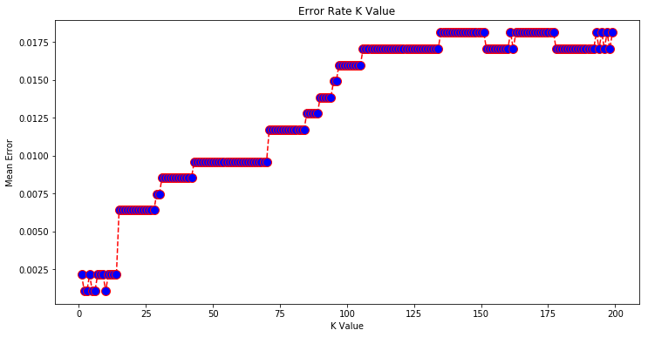
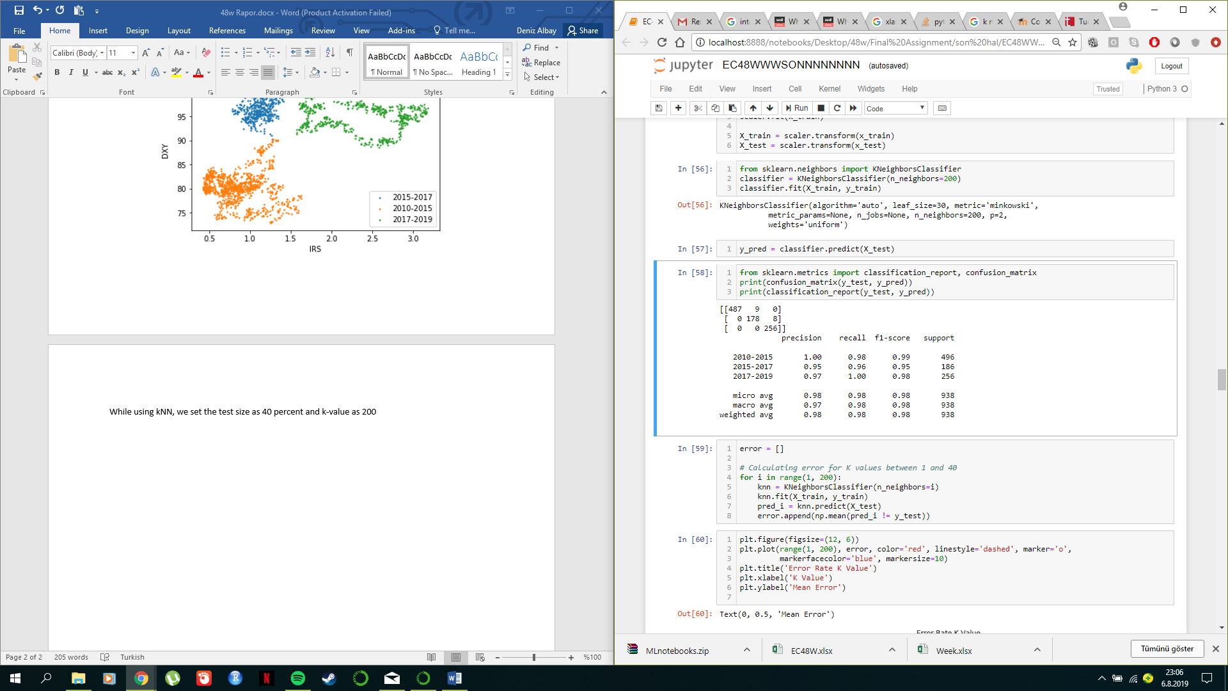
k-NN
Test Data: %40
K-value 200

Slide 9
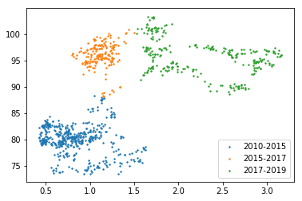
Stable Interest Rate
Permanent Interest Rate Hike
#All Data
#Predictions

Slide 10

Stable Interest Rate
Permanent Interest Rate Hike
#All Data
#Predictions

Slide 11
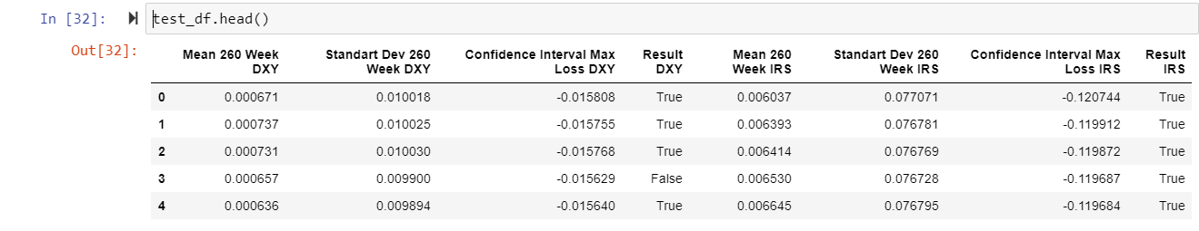
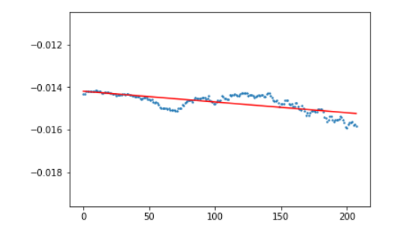
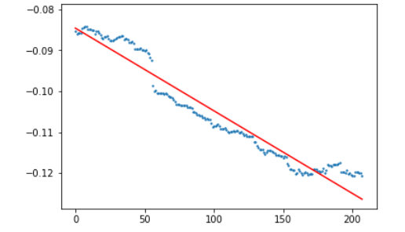
Linear Regression & Monte Carlo Simulation
DXY weekly change
IRS weekly change
week
week

Slide 12

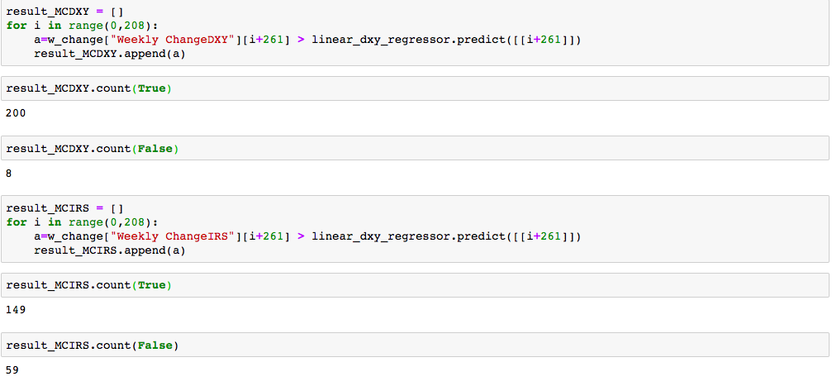
RESULT

Slide 13


Slide 14
Group Monte Carlo
Huseyin Albay
Furkan Demirbas
Betul Demirkol
Ugurcan Ocak

